Slide 1
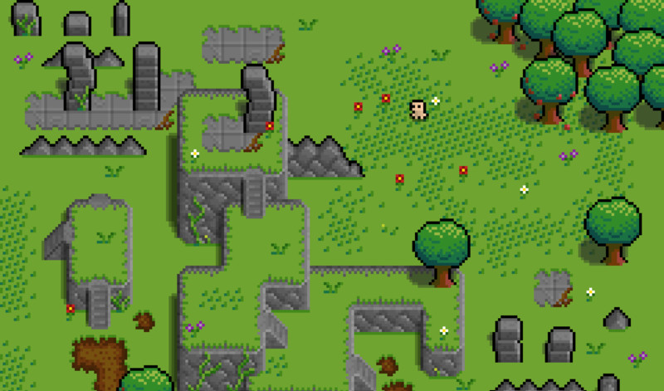

Green Sky Games
1 Bidhan / 2 Todd / 2+ Alex / 3 Mark / 4 Shan / 5 Hengyi / 6 Liz

Slide 2

01
Post Mortem

Slide 3
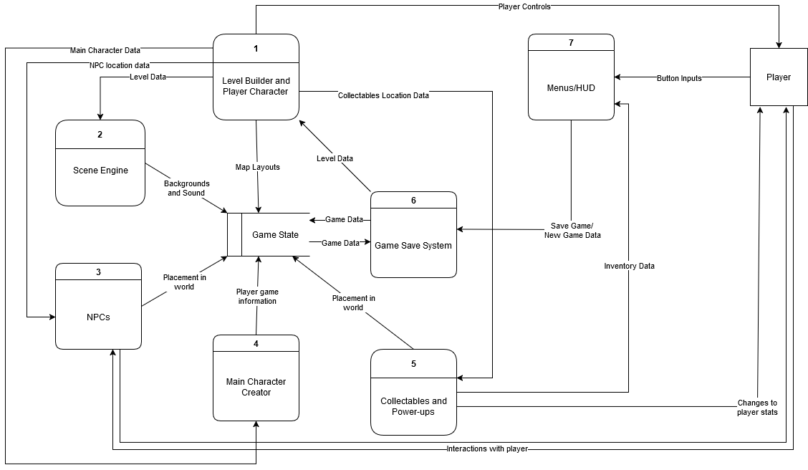
Data Flow Diagram 0
Speaking: - Alex, TL2+

Slide 4
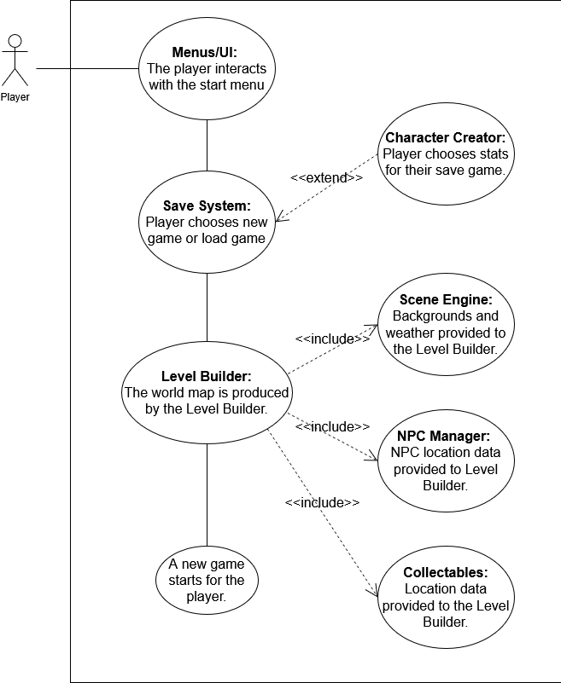
Team Member Breakdown
TL1: Save System
TL2: Storyline, dialogue, NPC responses
TL2+: Level Design, Terrain Interaction
TL3: Main Character Customization
TL4: Power-ups/Collectibles, Inventory
TL5: Scene Engine: Environment and Audio Systems
TL6: Game menus/ screens, BC Mode toggle
Speaking: - Alex, TL2+

Slide 5
02
GRASP Breakdown

Slide 6
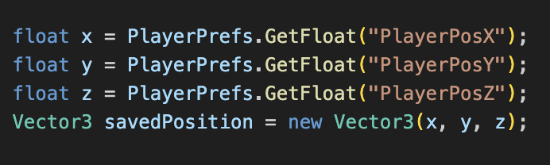
TL1:Bidhan
Contributions: Save System
Includes preserving progress during gameplay.
Enabling respawn at saved location.
Data stored: Player Position (X,Y,Z).
Storage: PlayerPrefs
High cohesion and low coupling.

Slide 7

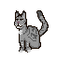
TL2:Todd Carter
1. Dialogue system
Dialogue box canvas with a Decorator pattern
Branching dialogue with multiple choices
Game events occurring from dialogue choices
2. NPCs
Combat and hostility response
Unique animations and sprites
3. Writing and storyline
Dialogue for each NPC
Created two different methods to reach victory
Commonly used stamp coupling for fairly low coupling overall
High sequential and informational cohesion, though became worse towards wrap up
Speaking: - Todd, TL2

Slide 8
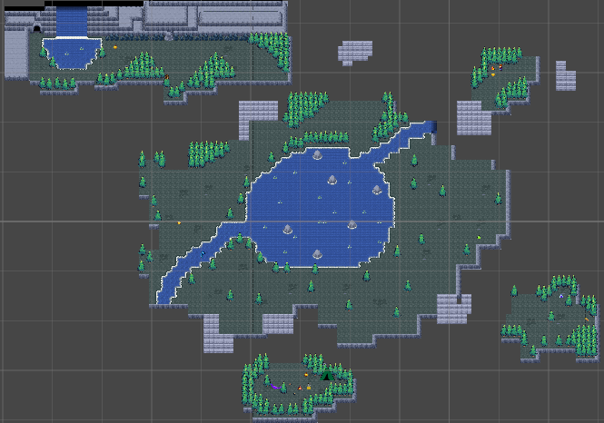
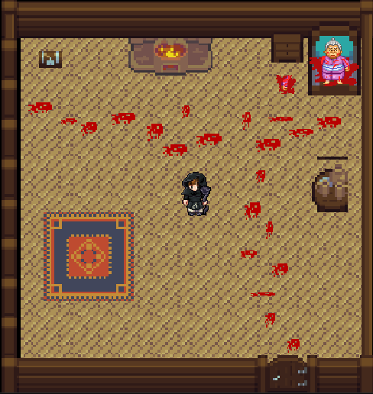
TL2+:
1. Level Design
Individual map layouts for levels 1 through 5
Level building with a Builder pattern
Transitions between game areas
Unique sprites and tile maps for different sections
2. Terrain Objects
Effects and responses for 5 different terrain object types
Various sprites and collision events
Utilized primarily stamp coupling for fairly low overall coupling​
Generally high cohesion through a mix of functional, sequential, and informational cohesion
Speaking: - Alex, TL2+

Slide 9
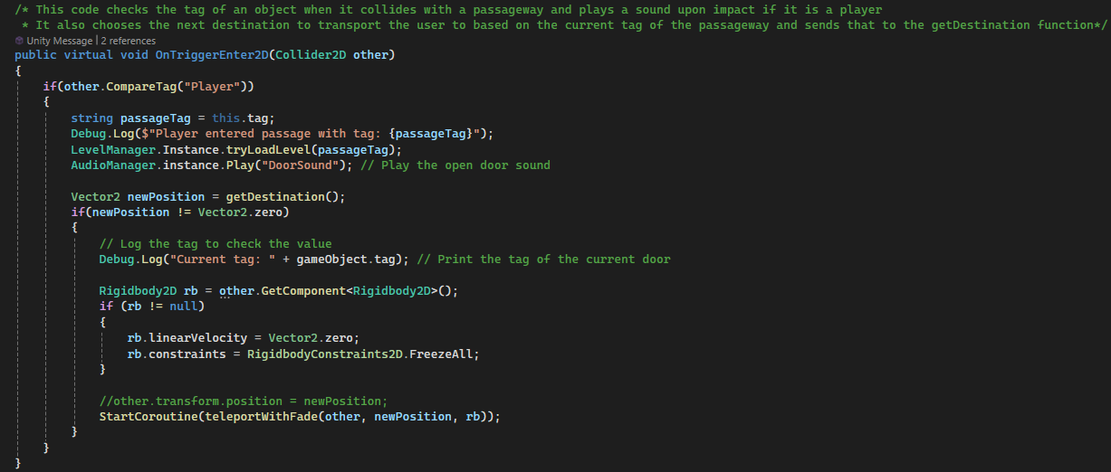
TL2+:
Speaking: - Alex, TL2+

Slide 10
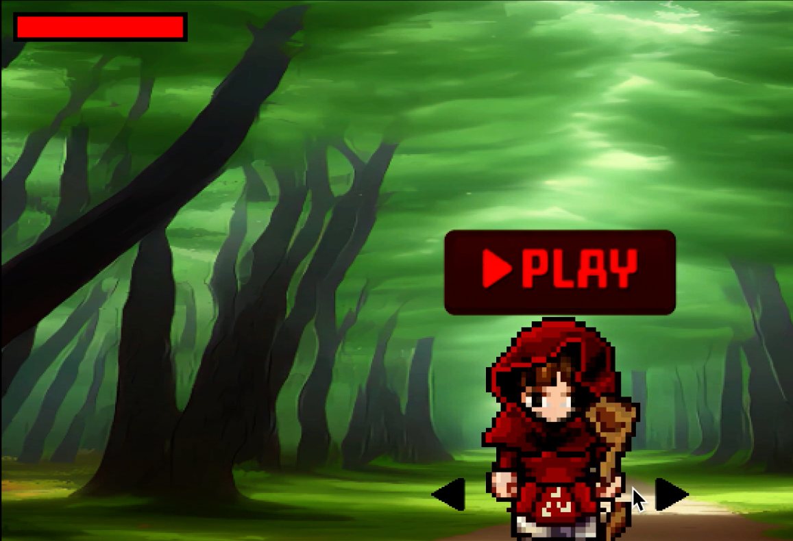
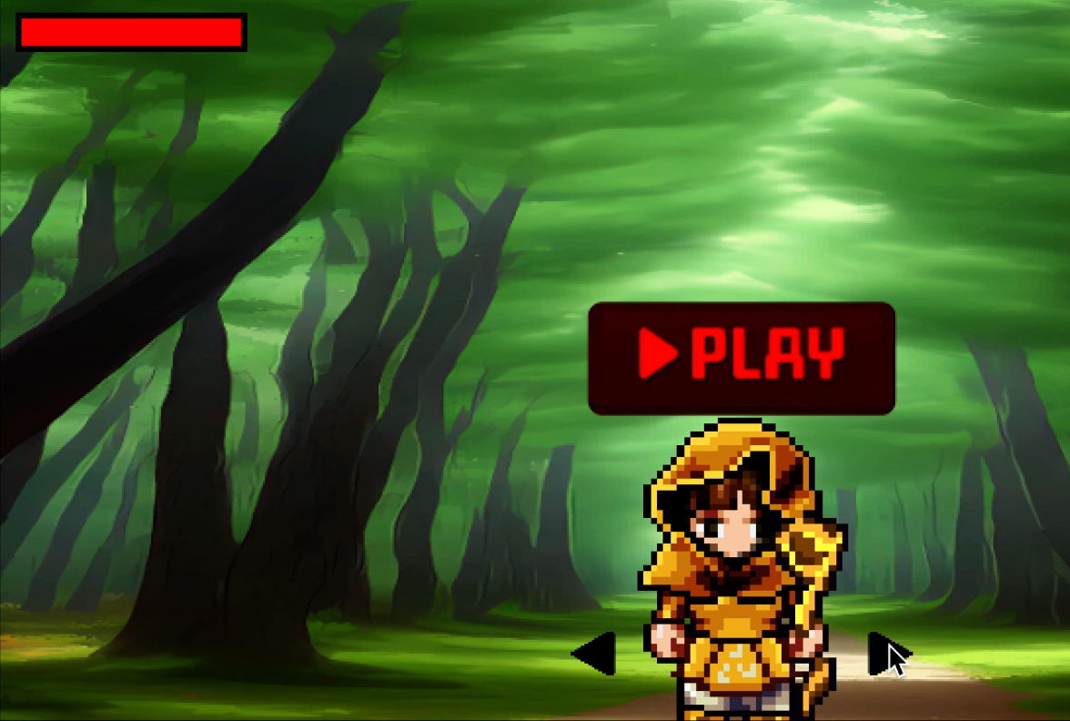
TL3:
Contributions:
Made different versions of Riding Hood (Red, Blue, Yellow, etc.)
Created a Character Selection Scene
Implemented animations to Riding Hood
Created a Health Bar for Riding Hood
Low coupling
High cohesion

Slide 11
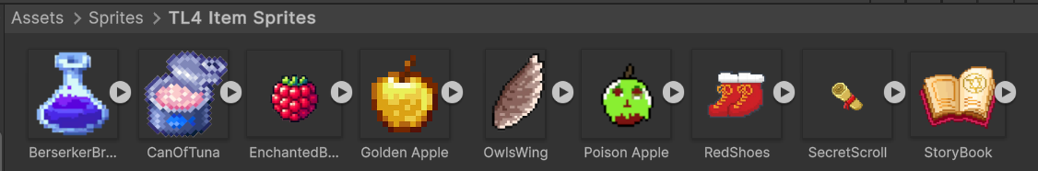
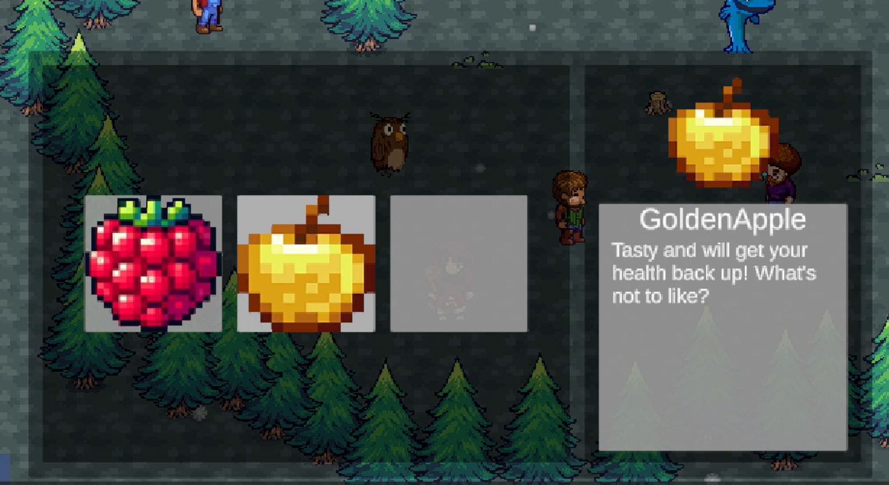
TL4:
1. Power-ups
Change player stats
Choice prompt on collision
Template Method pattern
Unique sprites
2. Collectibles
Automatically added to inventory
Returns bool to The Cat if in inventory for different ending
3. Inventory
Accessible at any time
Displays information on items
Items can be added, removed, or used
Slots increase with more clues gathered
Functional and sequential cohesion – moderately high
Speaking: - Shan, TL4

Slide 12
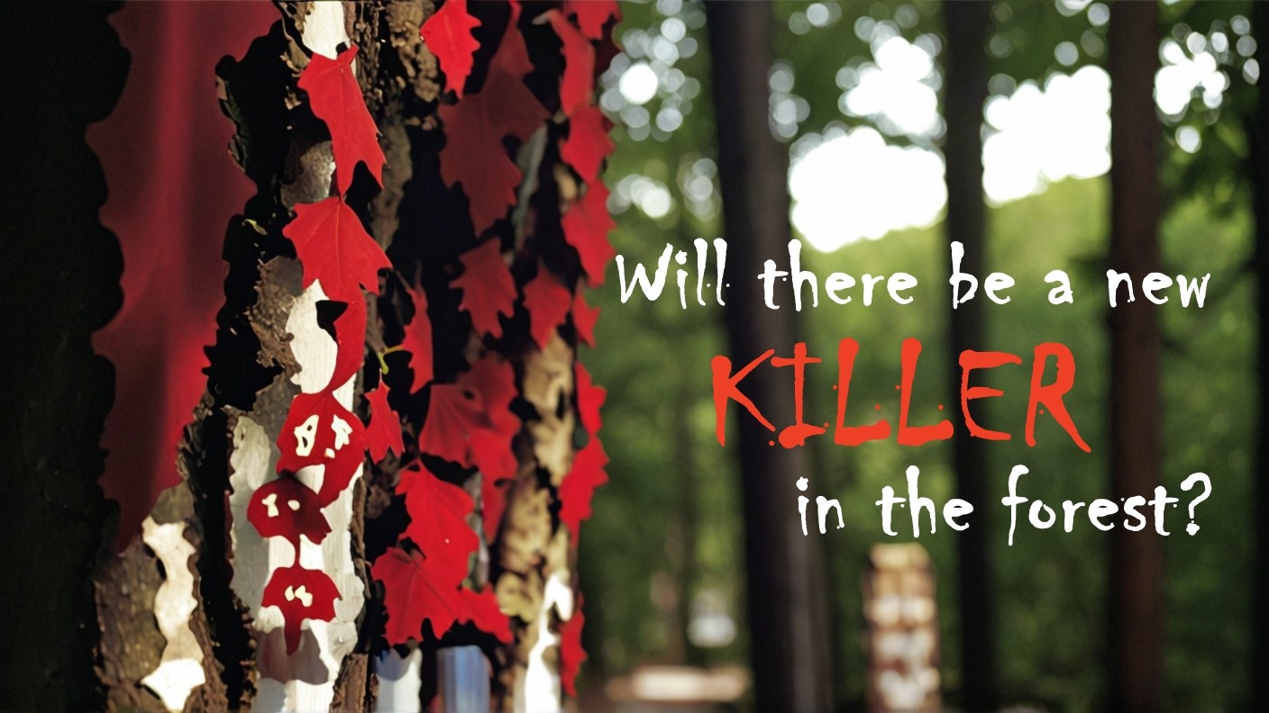
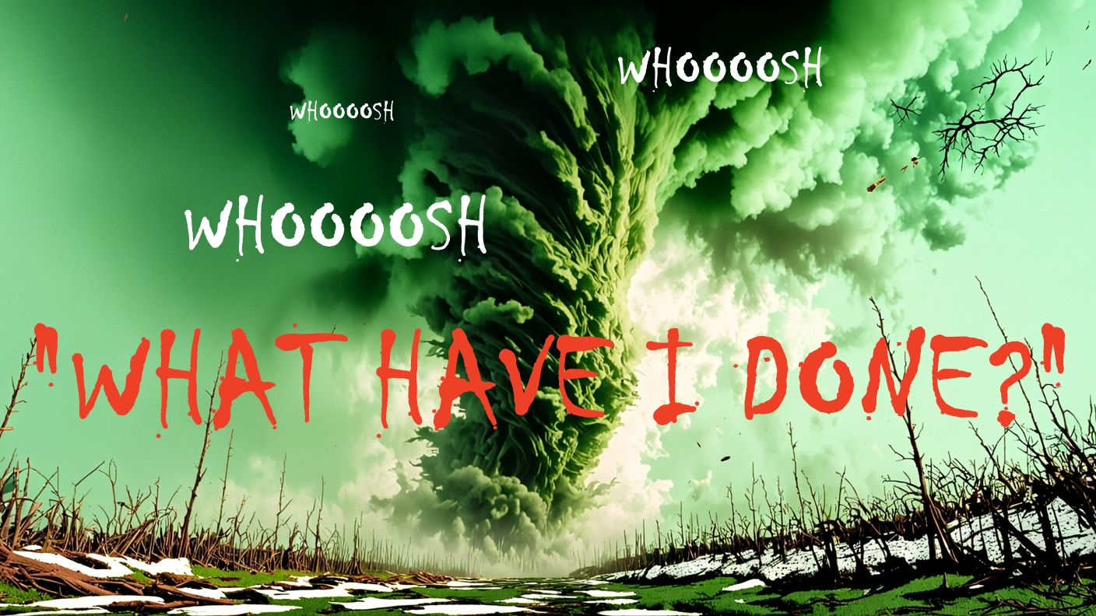
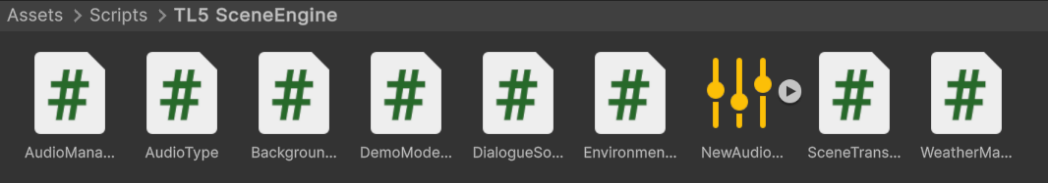
TL5: Hengyi Tian
1. Environment System
Weather System: 4 weather phenomena, including rain, Snow, Fog, and Dust
Transition Scenes: 7 transition scenes, including Green Sky and Tornados
2. Audio System
BGM System: 8 environmental sounds, 9 background sounds
Dialogue System: 11 dialogue sounds for NPCs
Sound Effects: 8 sound effects
3. Demo Mode
4. Game Poster

Slide 13
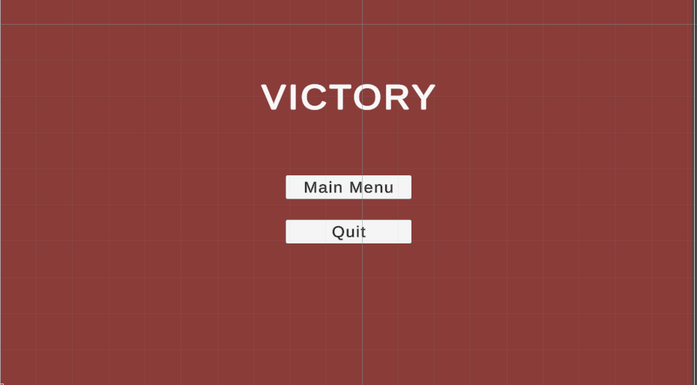
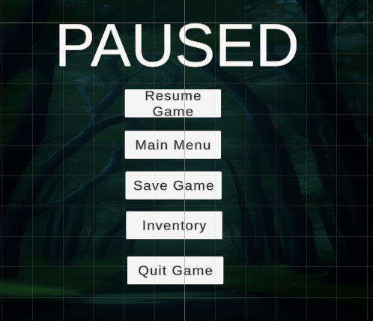
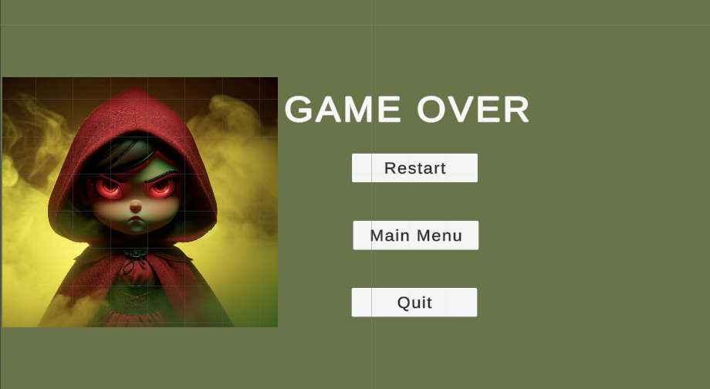
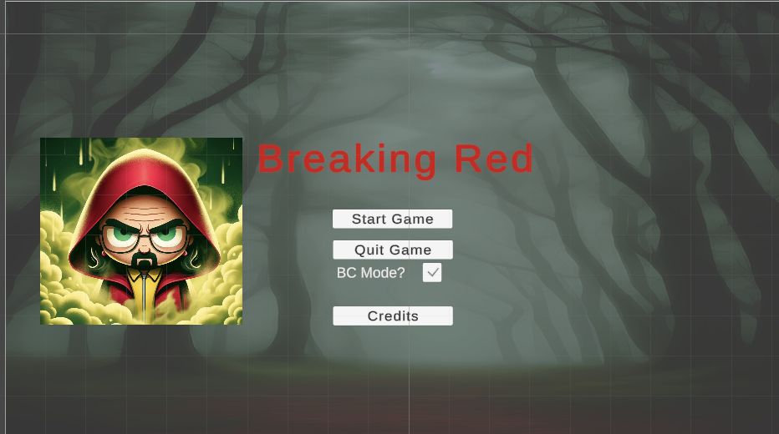
TL6:Liz
Contributions:
Start Menu
Used the façade pattern
Pause Menu (Prefab)
Used the singleton pattern
Victory Screen
Game Over Screen
Credits Screen
BC Mode (Toggle and behavior)
Coupling and Cohesion
Speaking: - Liz, TL6

Slide 14
03
Project Improvements

Slide 15
How to break down the project better
Reduce NPC reliance on player
Scene transitions more uniform (Start Menu to Level 1)
More emphasis on the creation of unit testing
Speaking: - Alex, TL2+

Slide 16
04
Course Improvements

Slide 17
How to make the course better.
Canvas Calendar descriptions explaining what deliverables are needed.
TL Presentations made earlier in the semester.
GitHub presentation made earlier before working on games.
General expectations for games described at the beginning of the course
Gantt chart additions: Unit Testing, Dynamic/Static Binding, Patterns, Coding Standards, Demo, Copyright Implementation
Speaking: - Alex, TL2+

Slide 18
05
Pair Programming

Slide 19
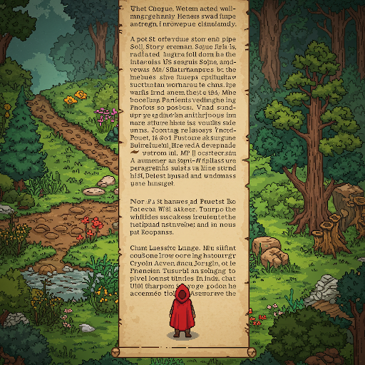
Pair Programming: Game Prologue
Action:
Full screen wall of text that displays the start to the storyline (Star Wars style).
Dialogue:
There will be text displayed on the screen for the player to read, as well as a voiceover for players who don’t want to.
Speaking: - Alex, TL2+

Slide 20
THANKS!
?
Any Questions?

